Slide 1
Digital Image Processing
Chapter 3: Intensity Transformations and Spatial Filtering

Slide 2
Background
Spatial domain process
where is the input image, is the processed image, and T is an operator on f, defined over some neighborhood of

Slide 3
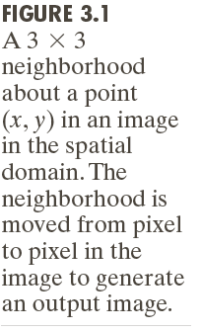
Neighborhood about a point

Slide 4
Gray-level transformation function
where r is the gray level of and s is the gray level of at any point

Slide 5
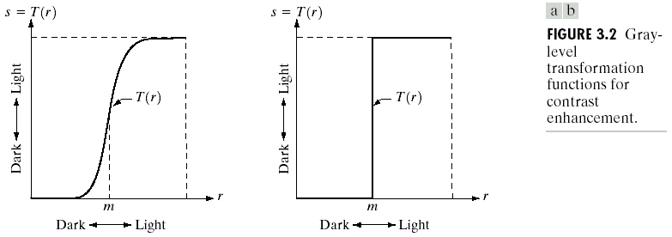
Contrast enhancement
For example, a thresholding function

Slide 6


Masks (filters, kernels, templates, windows)
A small 2-D array in which the values of the mask coefficients determine the nature of the process

Slide 7
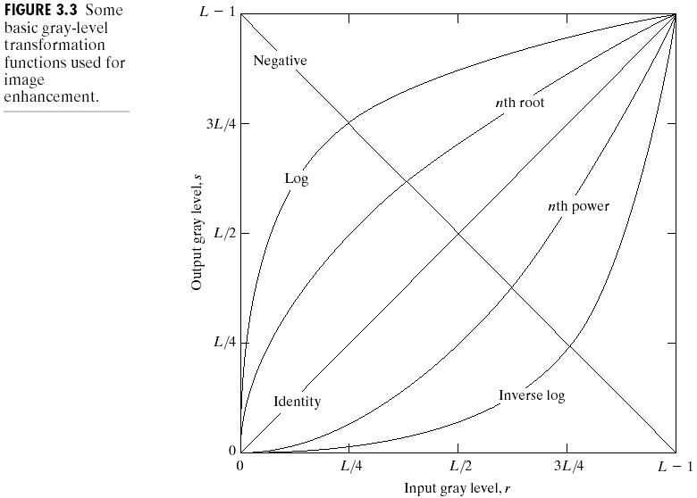
Some Basic Gray Level Transformations

Slide 8
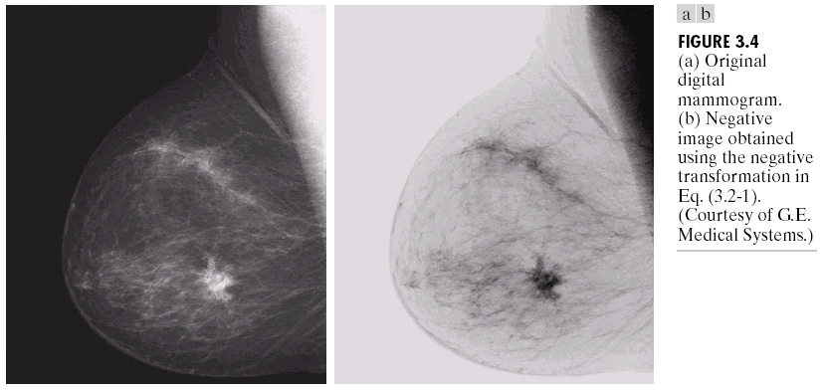
Image negatives
Enhance white or gray details

Slide 9
Log transformations
Compress the dynamic range of images with large variations in pixel values

Slide 10
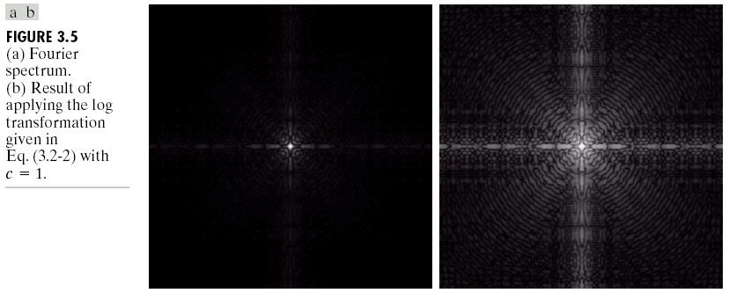
From the range 0- to the range 0 to 6.2

Slide 11
Power-law transformations
or
maps a narrow range of dark input values into a wider range of output values, while maps a narrow range of bright input values into a wider range of output values
: gamma, gamma correction

Slide 12
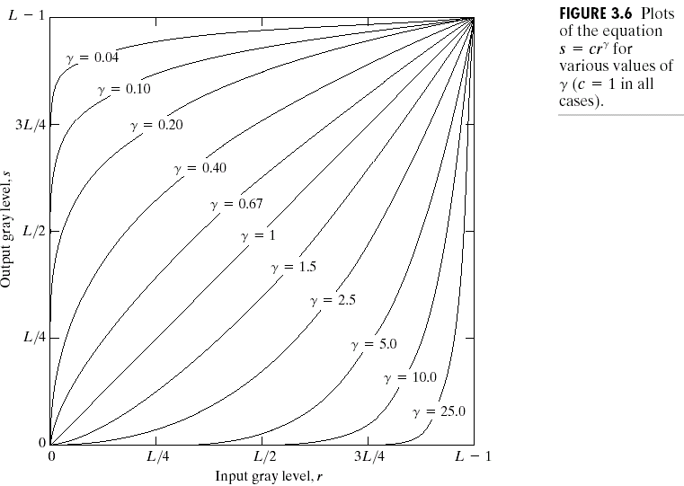

Slide 13
Monitor,

Slide 14
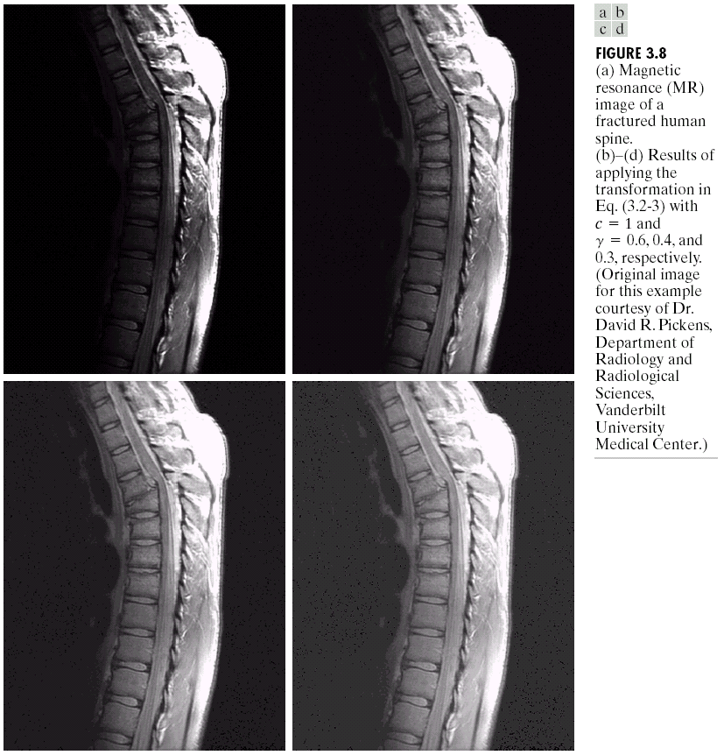

Slide 15
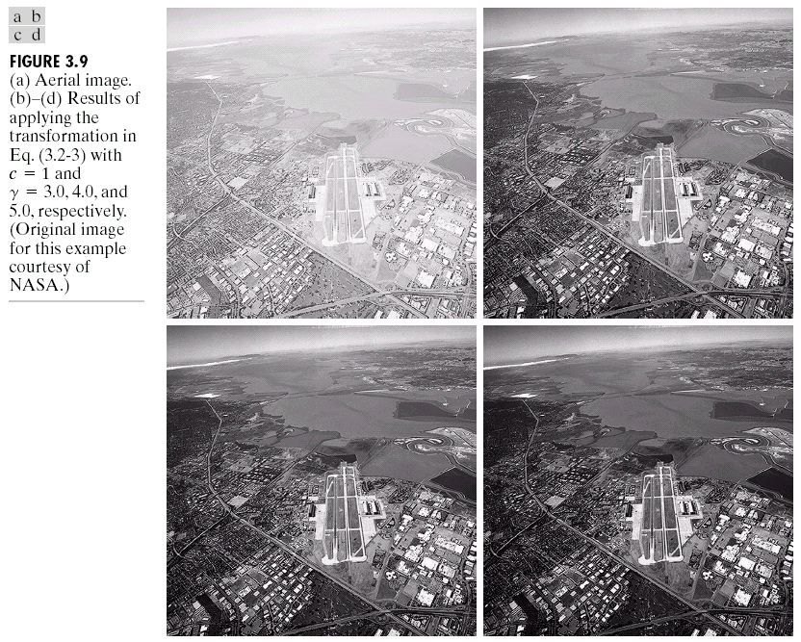

Slide 16
Piecewise-linear transformation functions
The form of piecewise functions can be arbitrarily complex

Slide 17
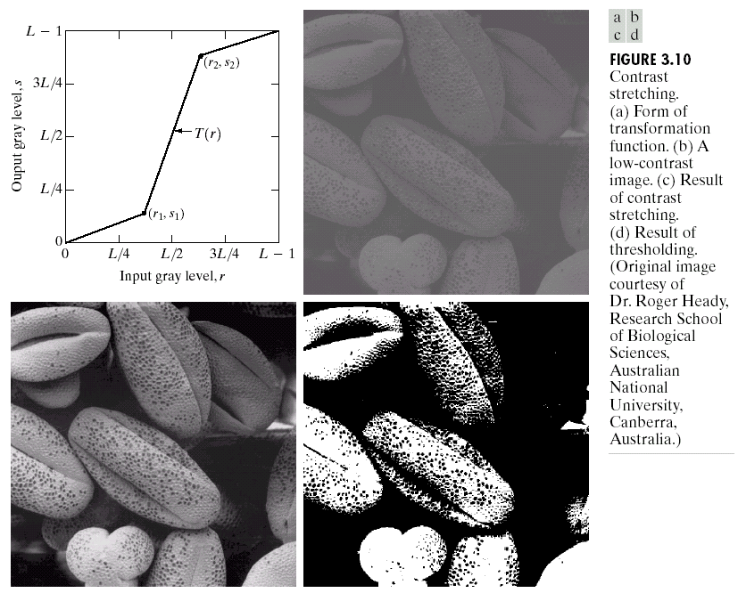



Contrast stretching

Slide 18
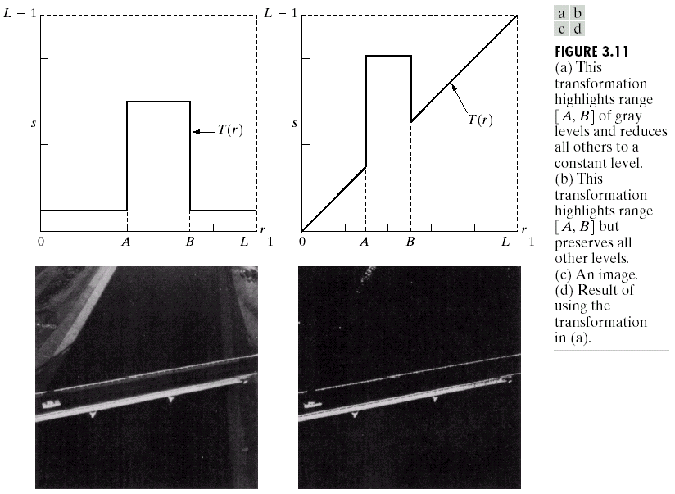





Gray-level slicing

Slide 19
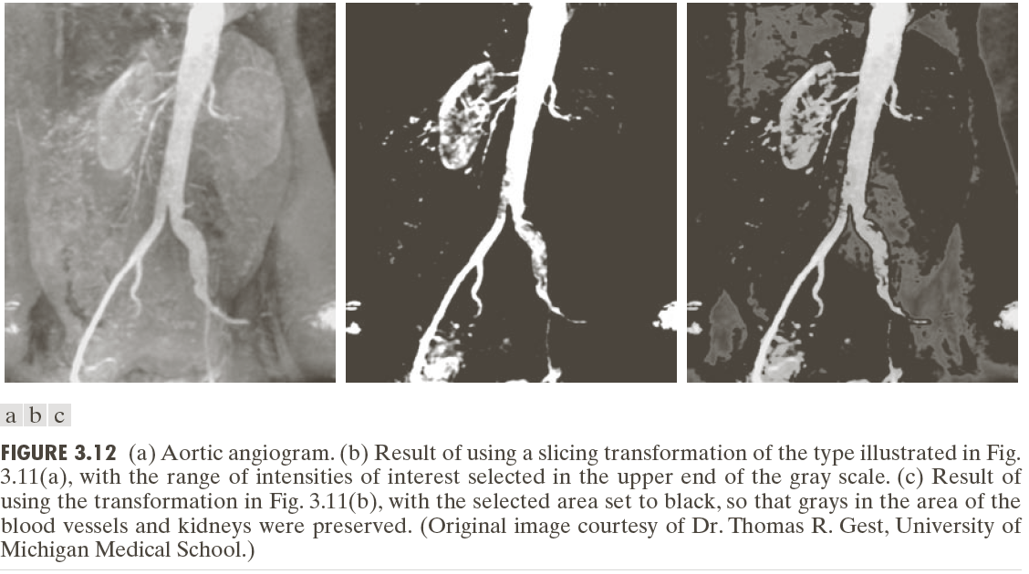

Slide 20
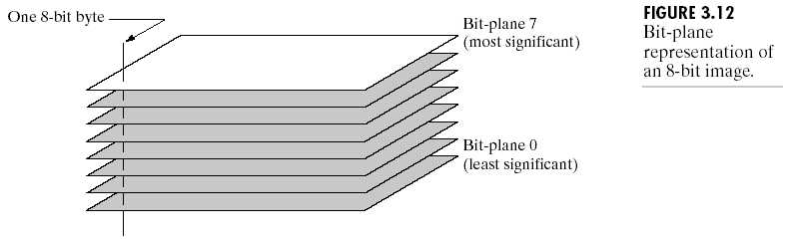
Bit-plane slicing

Slide 21
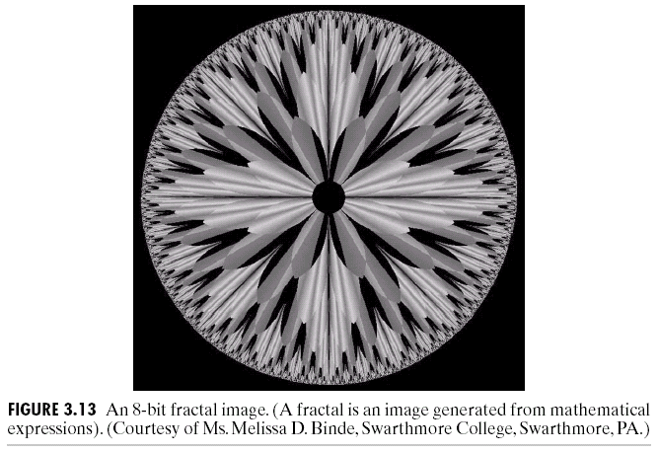

Slide 22
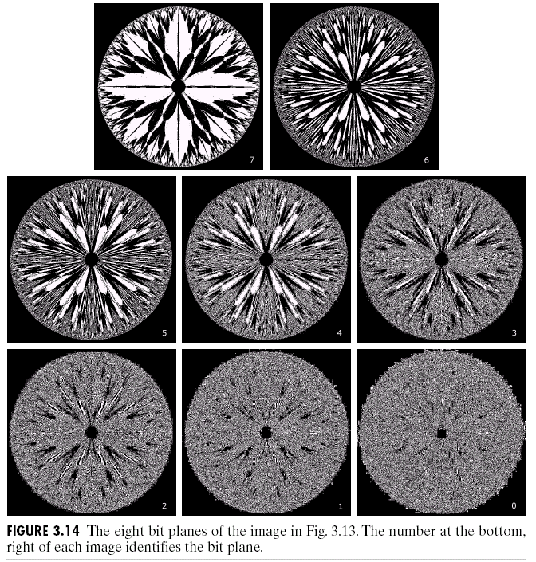











Slide 23
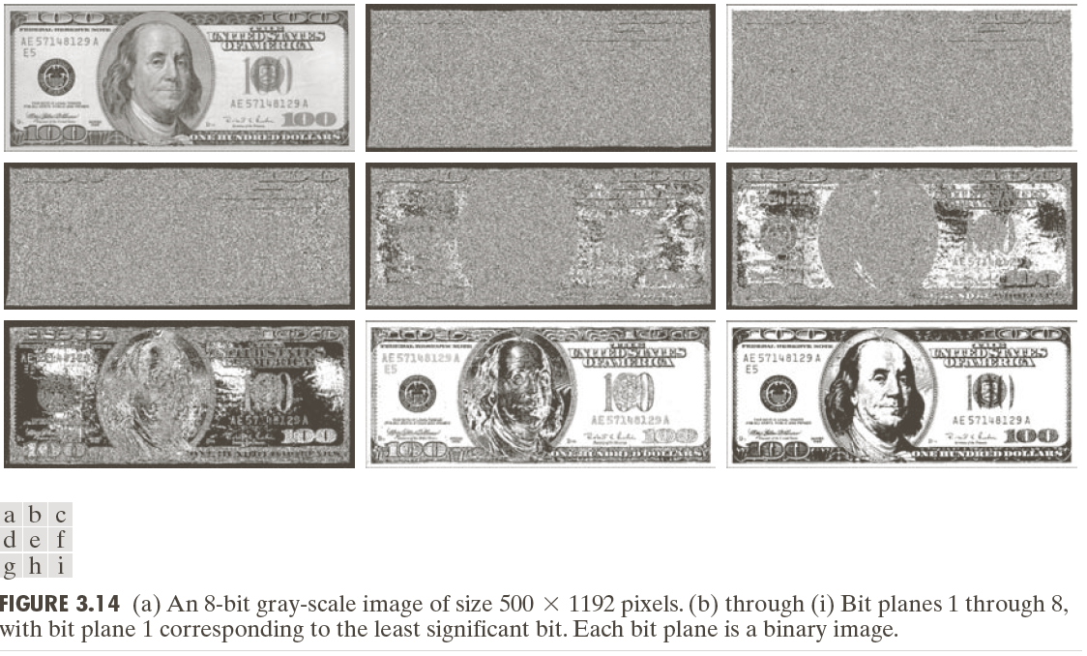

Slide 24
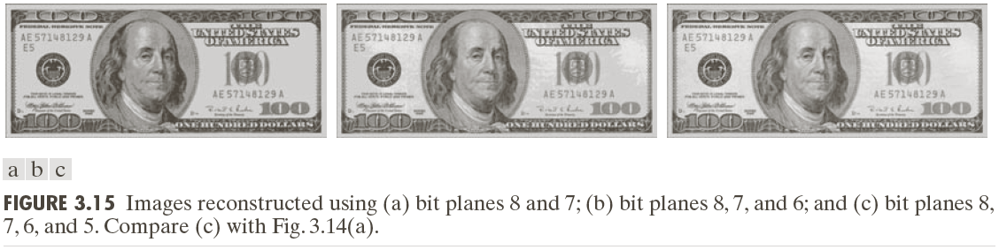




Slide 25
Histogram Processing
Histogram
where is the kth gray level and is the number of pixels in the image having gray level
Normalized histogram

Slide 26
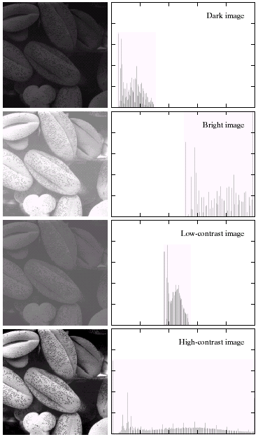

Slide 27
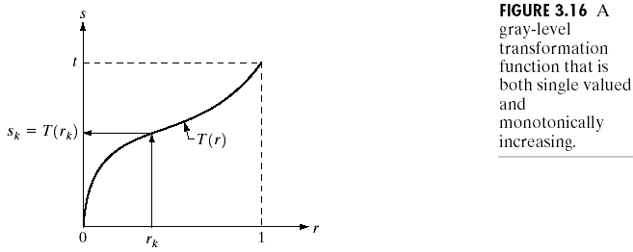
Histogram equalization

Slide 29
Probability density functions (PDF)

Slide 32
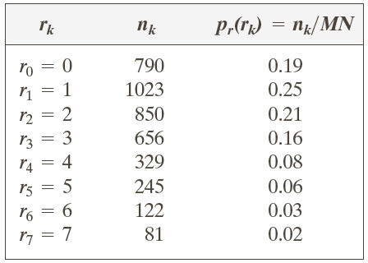
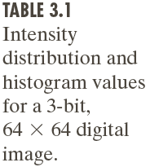













Slide 35
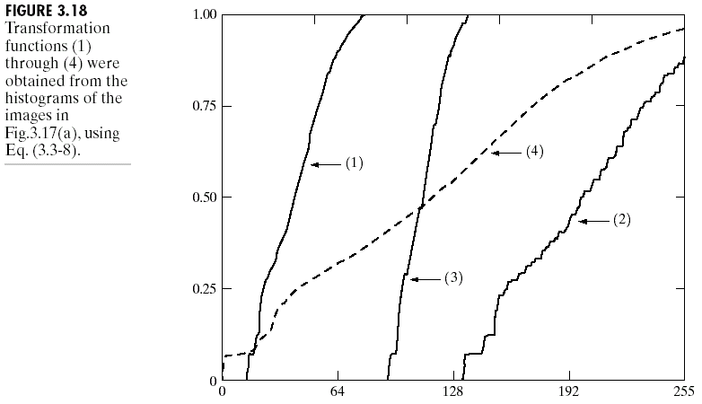

Slide 37
Histogram matching (specification)
is the desired PDF

Slide 39
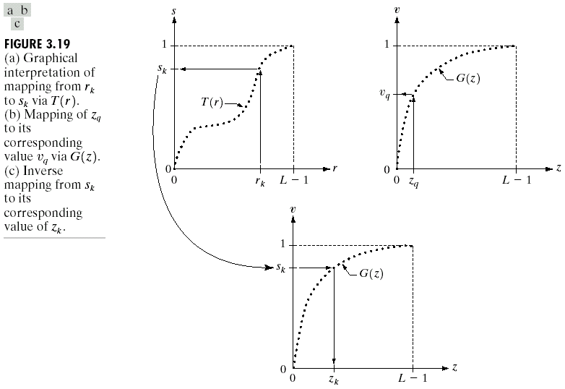

Slide 40
Histogram matching
Obtain the histogram of the given image, T(r)
Precompute a mapped level for each level
Obtain the transformation function G from the given
Precompute for each value of
Map to its corresponding level ; then map level into the final level

Slide 42
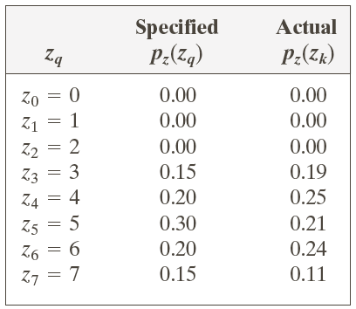

Slide 45
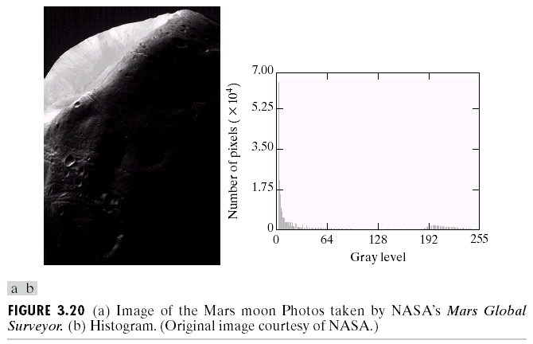

Slide 46
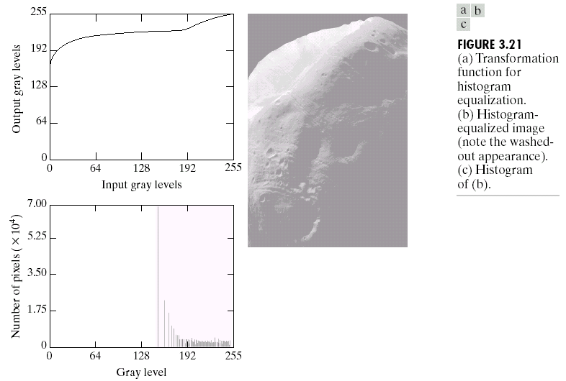

Slide 47
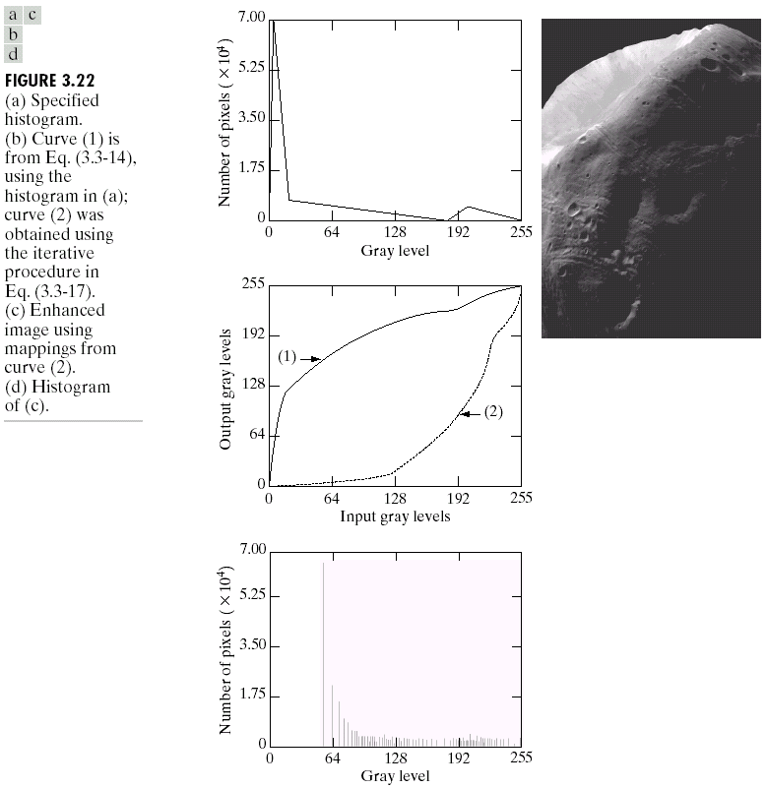

Slide 48
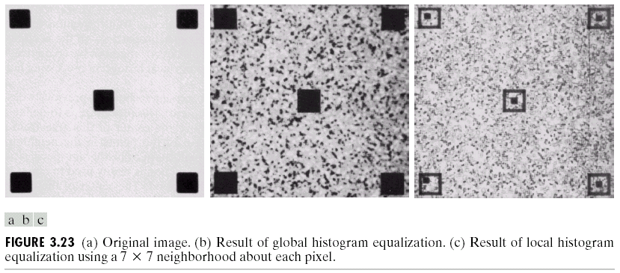
Local enhancement
Histogram using a local neighborhood, for example 7*7 neighborhood
部分做均等

Slide 49
Histogram using a local 3*3 neighborhood

Slide 50
Use of histogram statistics for image enhancement
denotes a discrete random variable
denotes the normalized histogram component corresponding to the ith value of
Mean

Slide 51
The nth moment
The second moment

Slide 52
Global enhancement: The global mean and variance are measured over an entire image
Local enhancement: The local mean and variance are used as the basis for making changes

Slide 53
is the gray level at coordinates (s,t) in the neighborhood
is the neighborhood normalized histogram component
mean:
local variance

Slide 54



are specified parameters
is the global mean
is the global standard deviation
Mapping

Slide 55
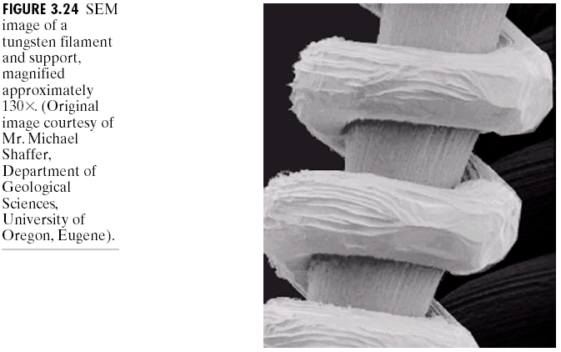

Slide 56
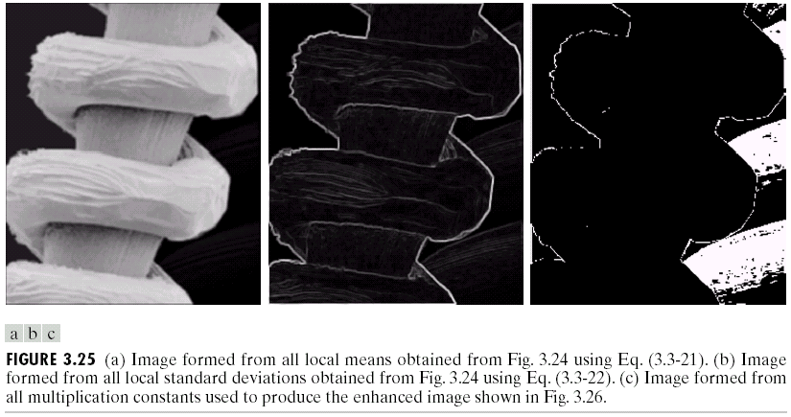



乘上原來的圖

Slide 57
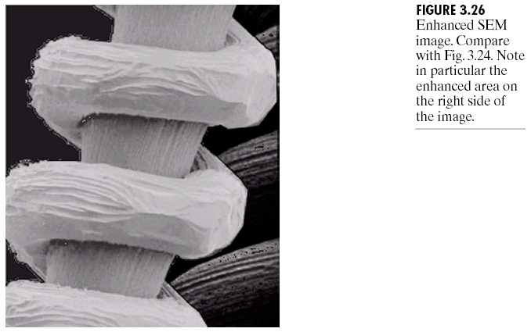






Slide 58
Fundamentals of Spatial Filtering
The Mechanics of Spatial Filtering

Slide 59
Image size:
Mask size:
and
and

Slide 60
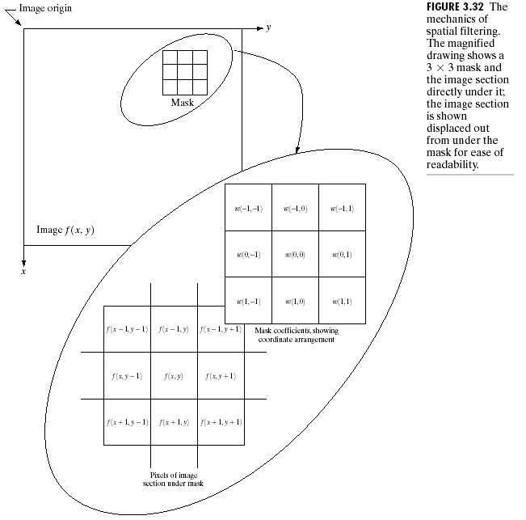












Slide 61
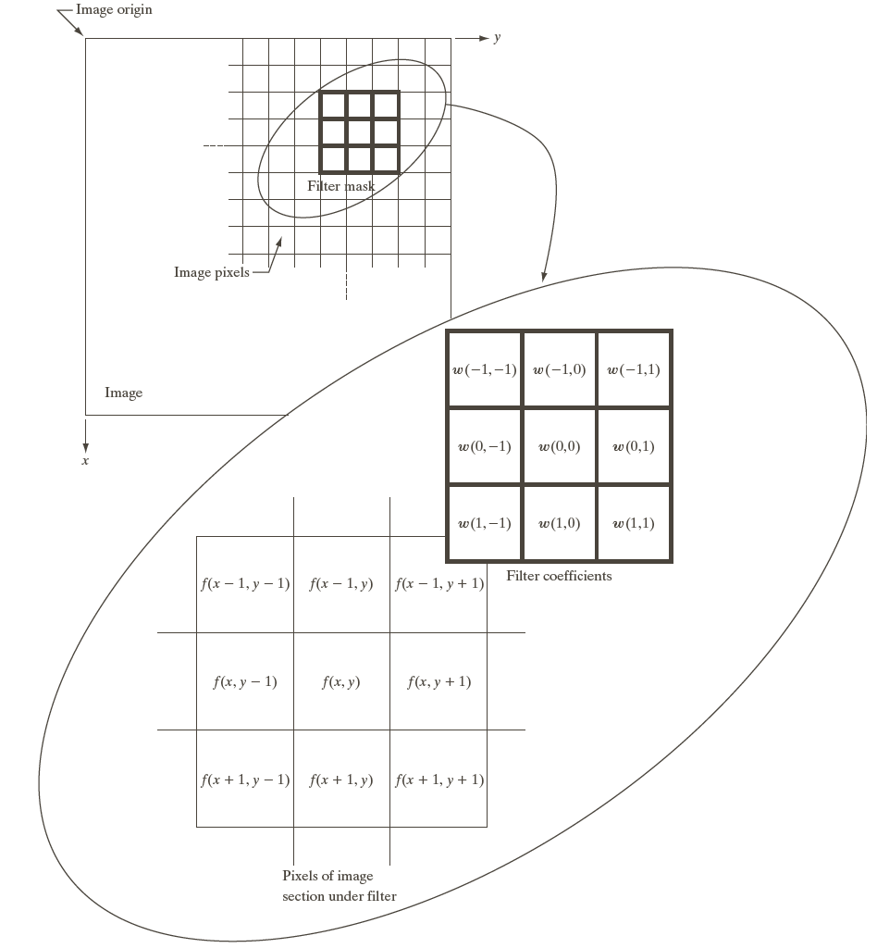

Slide 62

Spatial Correlation and Convolution

Slide 63
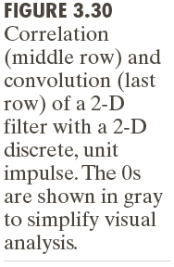

Slide 64
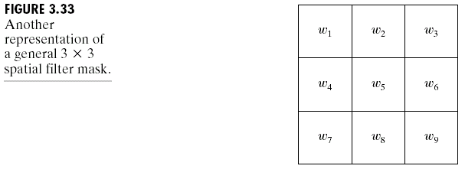
Vector Representation of Linear Filtering

Slide 65
Smoothing Spatial Filters
Smoothing Linear Filters
Noise reduction
Smoothing of false contours
Reduction of irrelevant detail

Slide 66
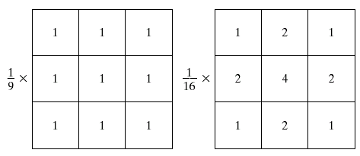

Slide 68
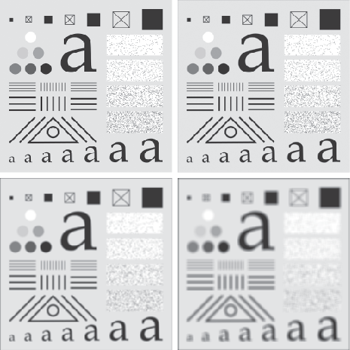
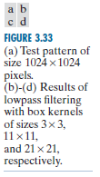

Slide 69
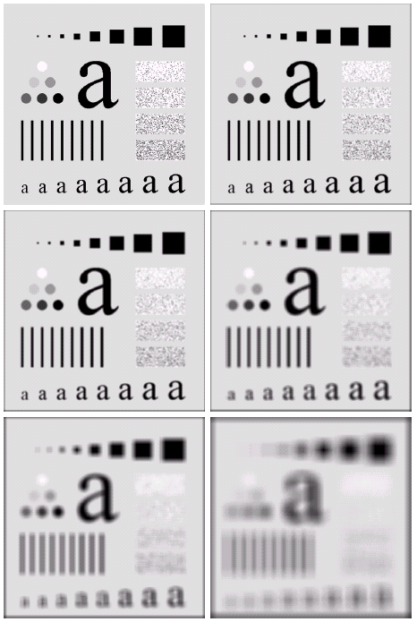
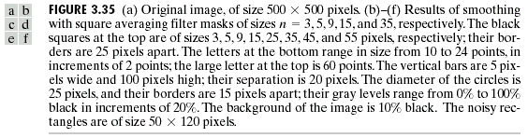

Slide 70
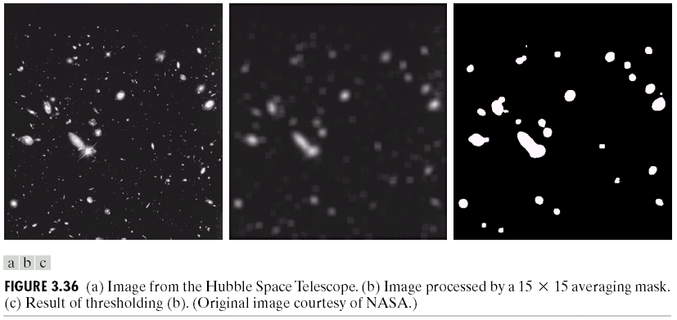

Slide 71
Order-statistic filters
median filter: Replace the value of a pixel by the median of the gray levels in the neighborhood of that pixel
Noise-reduction

Slide 72
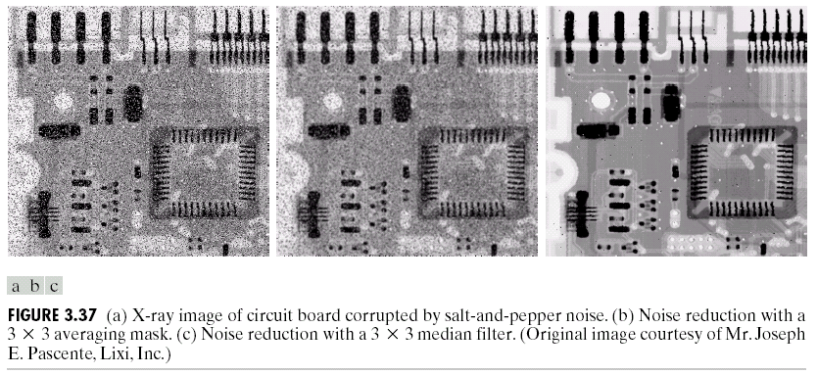

Slide 73
Sharpening Spatial Filters
Foundation
The first-order derivative
The second-order derivative

Slide 74
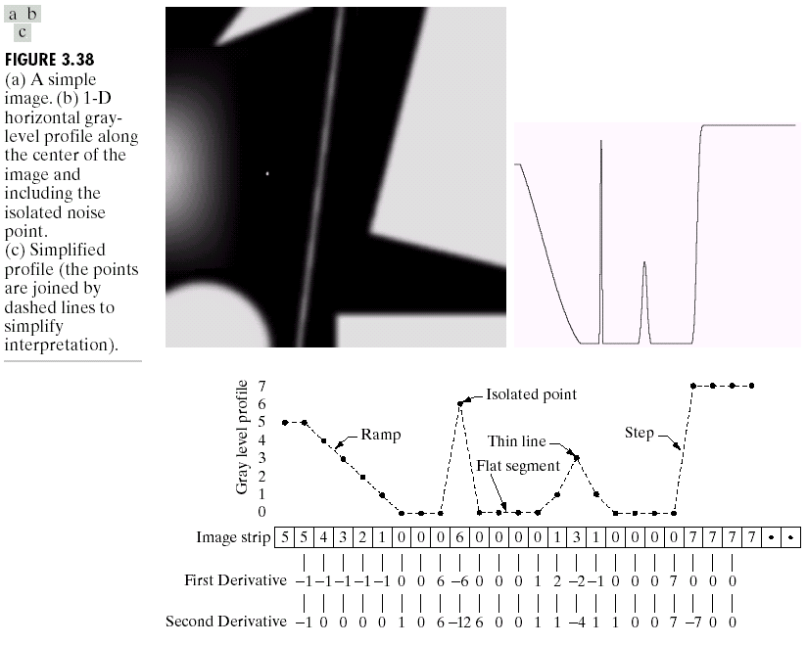

Slide 75
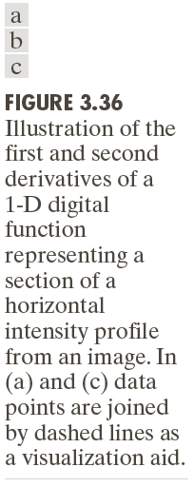

Slide 76
Use of second derivatives for enhancement-The Laplacian
Development of the method

Slide 78
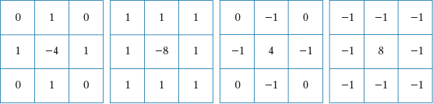
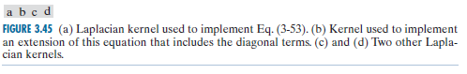

Slide 79
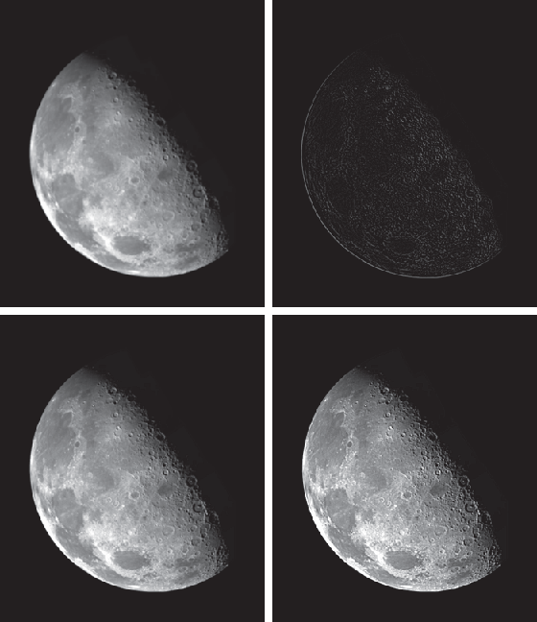
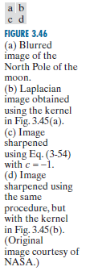

Slide 80
Simplifications

Slide 81
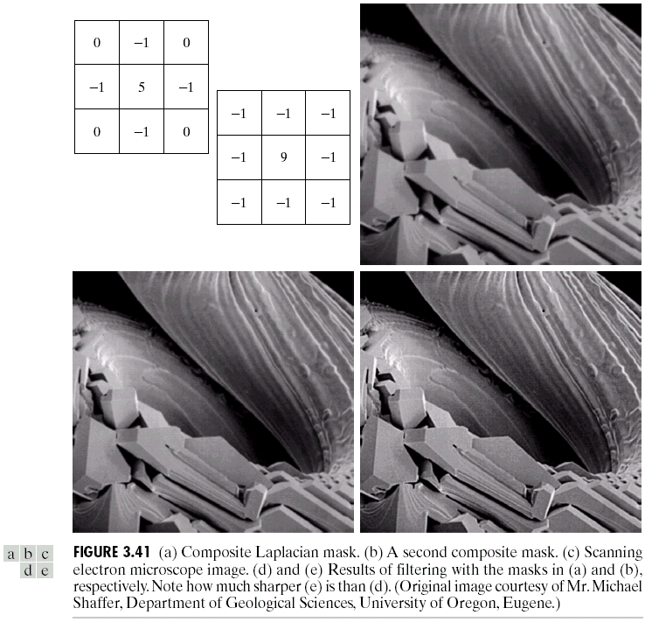






Slide 82
Unsharp masking and highboost filtering
Unsharp masking
Substract a blurred version of an image from the image itself
: The image, : The blurred image

Slide 83
High-boost filtering

Slide 86
Using first-order derivatives for (nonlinear) image sharpening—The gradient

Slide 87
The magnitude is rotation invariant (isotropic)

Slide 88
Computing using cross differences, Roberts cross-gradient operators
and

Slide 89
Sobel operators
A weight value of 2 is to achieve some smoothing by giving more importance to the center point

Slide 90
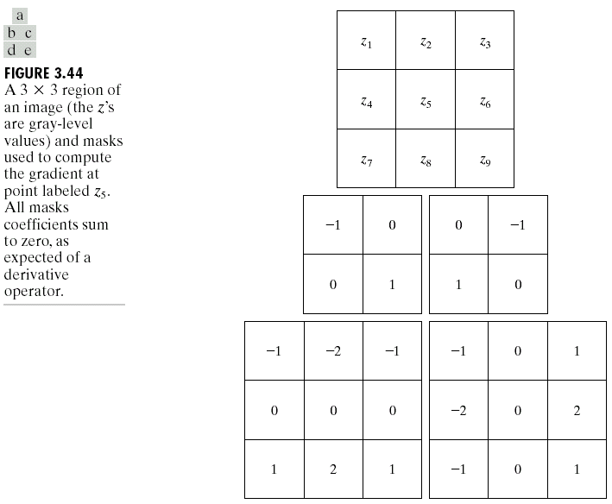

Slide 91
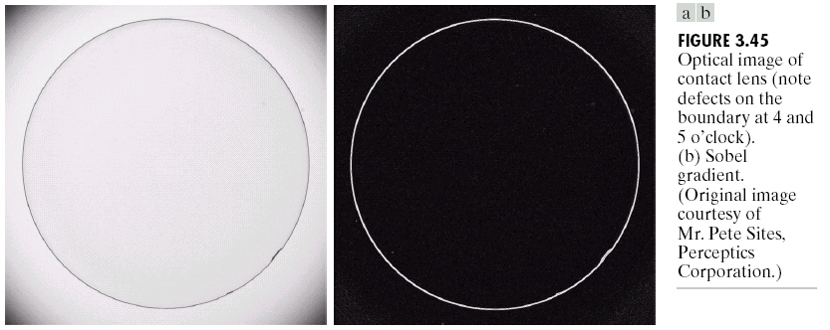

Slide 92
Combining Spatial Enhancement Methods
An example
Laplacian to highlight fine detail
Gradient to enhance prominent edges
Smoothed version of the gradient image used to mask the Laplacian image
Increase the dynamic range of the gray levels by using a gray-level transformation

Slide 93



Slide 94



Slide 95

Problems
3.9
Do the following:
(b) Show that the inverse discrete transformation in Eq. (3-16) satisfies conditions (a’) and (b) in Section 3.3 only if none of the intensity levels $r_{k}, k=0, 1, 2,…, L−1$, are missing in the original image.

Slide 96

Problems
3.10
Two images, $f(x, y)$ and $g\left(x, y\right)$ have unnormalized histograms $h_{f}$ and $h_{g}$. Give the conditions (on the values of the pixels in $f$ and $g$) under which you can determine the histograms of images formed as follows:
(a) $f\left(x, y\right)+g(x,y)$
Show how the histograms would be formed in each case. The arithmetic operations are element-wise operations, as defined in Sections 2.6.

Slide 97

Problems
3.11
Assume continuous intensity values, and suppose that the intensity values of an image have the PDF $p_{r}\left(r\right)=2r/{(L−1)}^{2}$ for $0≤r≤L−1$, and $p_{r}\left(r\right)=0$ for other values of $r$.
(a) Find the transformation function that will map the input intensity values, $r$, into values, $s$, of a histogram-equalized image.
(b) Find the transformation function that (when applied to the histogram-equalized intensities, $s$) will produce an image whose intensity PDF is $p_{z}\left(z\right)=3z^{2}/{(L−1)}^{3}$ for $0≤z≤L−1$ and $p_{z}\left(z\right)=0$ for other values of $z$.

Slide 98

Problems
3.18
You are given the following kernel and image:
$w=\left[\begin{matrix}1 & 2 & 1 \\ 2 & 4 & 2 \\ 1 & 2 & 1\end{matrix}\right]$ $f=\left[\begin{matrix}0 & 0 & 0 & 0 & 0 \\ 0 & 0 & 1 & 0 & 0 \\ 0 & 0 & 1 & 0 & 0 \\ 0 & 0 & 1 & 0 & 0 \\ 0 & 0 & 0 & 0 & 0\end{matrix}\right]$
(a) Given a sketch of the area encircled by the large ellipse in Fig. 3.28 when the kernel is centered at point (2, 3) (2nd row, 3rd col) of the image shown above. Show specific values of $w$ and $f$.

Slide 99

Problems
3.18 (continued)
(b) Compute the convolution $w⋆f$ using the minimum zero padding needed. Show the details of your computations when the kernel is centered on point (2, 3) of $f$, and then show the final full convolution result.
(c) Repeat (b), but for correlation, $w⋄f$.

Slide 100

Problems
3.20
The kernel, $w$, in Problem 3.18 is separable.
(a) By inspection, find two kernels, $w_{1}$ and $w_{2}$ so that $w=w_{1}⋆w_{2}$.

Slide 101
Problems
3.31
An image is filtered with a kernel whose coefficients sum to 1. Show that the sum of the pixel values in the original and filtered images is the same.

Slide 102

Problems
3.36
With reference to order-statistic filters (see Section 3.5):
(a) We mentioned that isolated clusters of dark or light (with respect to the background) pixels whose area is less than one-half the area of a median filter are force to the median value of the neighbors by the filter. Assume a filter of size $n×n$ ($n$ odd) and explain why this is so.

Slide 103

Problems
3.39
Show that the Laplacian defined in Eq. (3-50) is isotropic (invariant to rotation). Assume continuous quantities. From Table 2.3, coordinate rotation by an angle $θ$ is given by
$x^{′}=x\cos{θ}−y\sin{θ}$ and $y^{′}=x\sin{θ}+y\cos{θ}$
where $\left(x, y\right)$and $(x^{′}, y^{′})$ are the unrotated and rotated coordinates, respectively.

Slide 104
Problems
3.40
You saw in Fig. 3.46 that the Laplacian with a -8 in the center yields sharper results than the one with a -4 in the center. Explain the reason why.

Slide 105

Problems
3.41
Give a $3×3$ kernel for performing unsharp masking in a single pass through an image. Assume that the average image is obtained using a box filter of size $3×3$.

